Slide 1
Curve Modeling
Bézier Curves
Dr. S.M. Malaek
Assistant: M. Younesi

Slide 2
Introduction
Question: Why do we need new forms of parametric curves?
Answer: Those parametric curves discussed are not very geometric.

Slide 3
Introduction
Given such a parametric form, it is difficult to know the underlying geometry it represents without some further analysis.
It is almost impossible to predict the change of shape if one or more coefficient are modified.

Slide 4
Introduction
In practice, designers or users usually do not care about the underlying mathematics and equation.

Slide 5
Introduction
A system that supports users to design curves must be:
Intuitive: We expect that every step.
Flexible: The system should provide the users with more control for designing and editing the shape of a curve.
Easy: The way of creating and editing a curve should be easy.

Slide 6
Introduction
Unified Approach: The way of representing, creating and editing different types of curves (e,g., lines, conic sections and cubic curves) must be the same.
Invariant: The represented curve will not change its geometry under geometric transformation (translation, rotation, …)

Slide 7
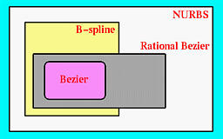
Introduction
Bézier, B-spline and NURBS curves advantage:
A user layouts a set of control points for the system.
A user can change the positions of some control points and some other characteristics for modifying the shape of curve.

Slide 8
Introduction
If necessary, a user can add control points.
They are very geometric, intuitive.
The transition from curve to surface will not cause much difficulty.

Slide 9
Bézier
Curves

Slide 10
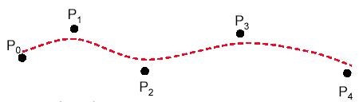
Bézier Curves
Bézier splines are:
spline approximation method;
useful and convenient for curve and surface design;
easy to implement;
available in Cad system, graphic package, drawing and painting packages.

Slide 11
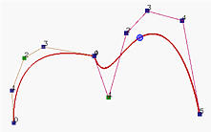
Bézier Curves
In general, a Bézier curve section can be fitted to any number of control points.
The number of control points to be approximated and their relative position determine the degree of the Bézier polynomial.

Slide 12
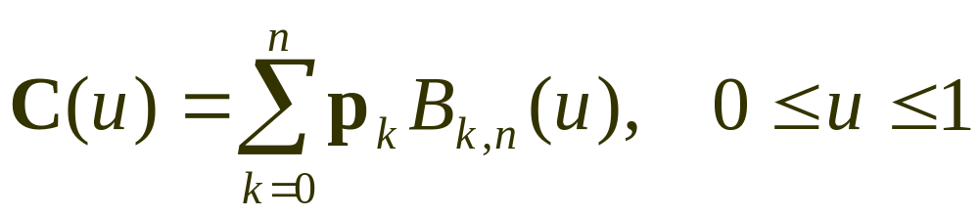
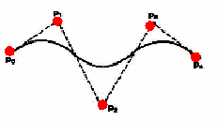
Bézier Curves
Given n+1 control point positions:
These coordinate points can be blended to produced the following position vector C(u), which describes the path of an approximating Bézier polynomial function between P₀ and P_{n}.

Slide 13
Properties
of
Bézier ‍Curves

Slide 14
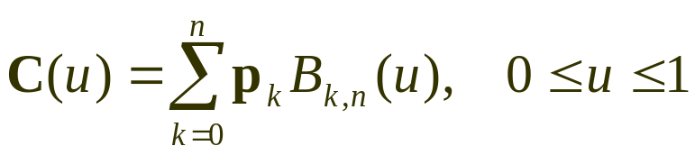
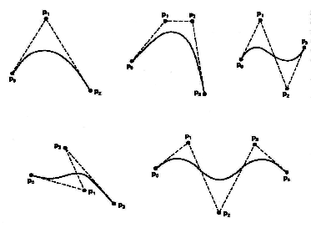
Properties of a Bézier ‍Curve
The degree of a Bézier curve defined by n+1 control points is n:
Parabola Curve
Cubic Curve
Cubic Curve
Cubic Curve

Slide 15
Properties of a Bézier ‍Curve
The curve passes though the first and the last control point C(u) passes through P₀ and P_{n}.

Slide 16
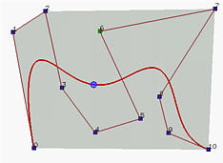
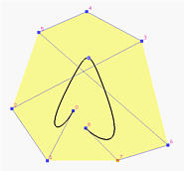
Properties of a Bézier ‍‍‍Curve
Bézier curves are tangent to their first and last edges of control polyline.
2
7
4
6
5
1
3
3
8
2
0
5
8
9
6
0
4
10
1
7

Slide 17
Properties of a Bézier Curve
The Bézier curve lies completely in the convex hull of the given control points.
Note that not all control points are on the boundary of the convex hull. For example, control points 3, 4, 5, 6, 8 and 9 are in the interior. The curve, except for the first two endpoints, lies completely in the convex hull.

Slide 18
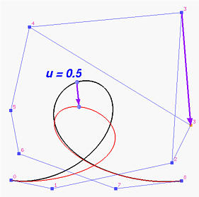
Properties of a Bézier ‍‍Curve
Moving control points:

Slide 19
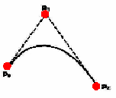

Properties of a Bézier ‍‍Curve
Moving control points:

Slide 20
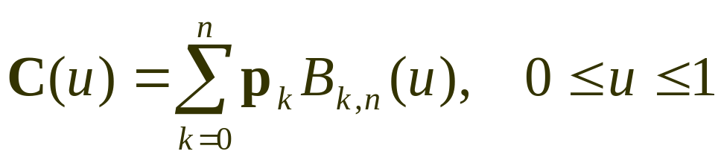

Bézier Curves
The point that corresponds to u on the Bézier curve is the "weighted" average of all control points, where the weights are the coefficients B_{k,n}(u).

Slide 21
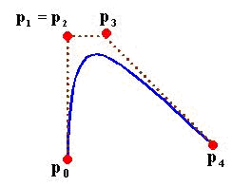

Design Techniques Using Bézier ‍Curve
(Weights)
‍‍Multiple control points at a single coordinate position gives more weight to that position.

Slide 22
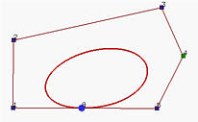

Design Techniques Using Bézier ‍Curve
(Closed Curves)
‍‍Closed Bézier curves are generated by specifying the first and the last control points at the same position.
4
5
3
2
0
8
6
1
7
‍‍Note: Bézier curves are polynomials which cannot represent circles and ellipses.

Slide 23
Properties of a Bézier Curve
If an affine transformation is applied to a Bézier curve, the result can be constructed from the affine images of its control points.

Slide 24
Construction
of
Bézier ‍Curves

Slide 25
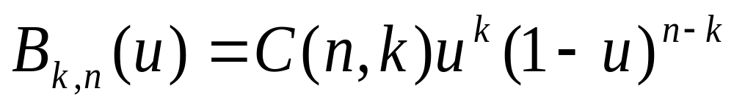
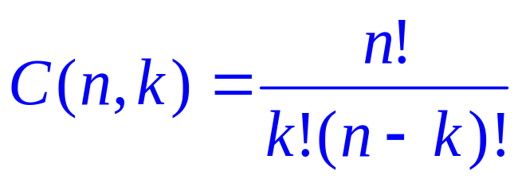
Bézier Curves
Given n+1 control point positions:
The Bézier blending functions are the Bernstein polynomials:
The C(n,k) are the binomial coefficients:

Slide 26
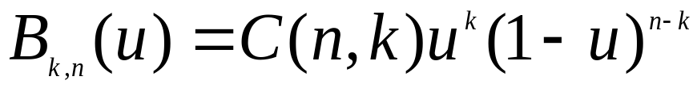
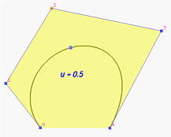
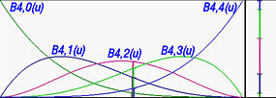

Properties of a Bézier Curve
All basis functions are positive and their sum is always 1

Slide 27
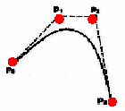
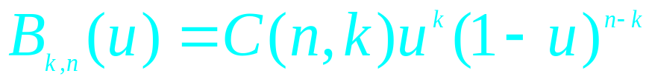
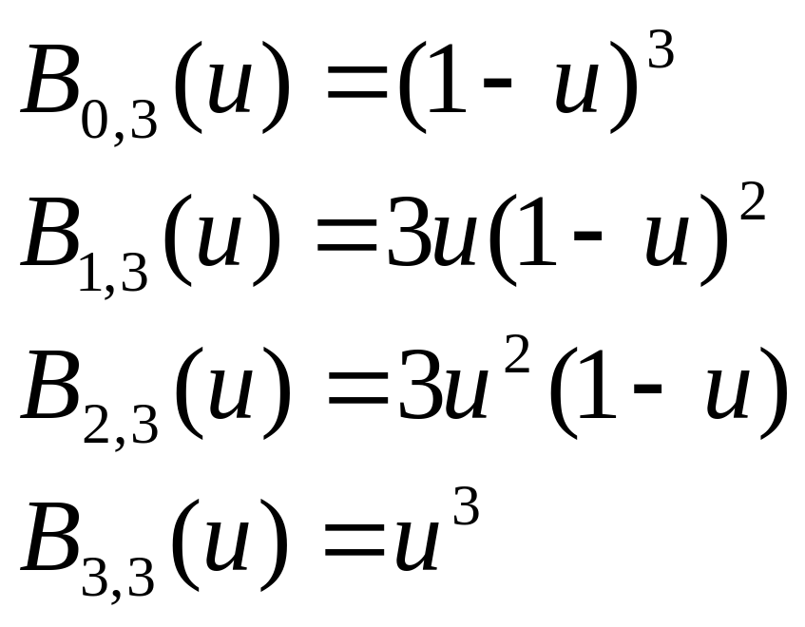
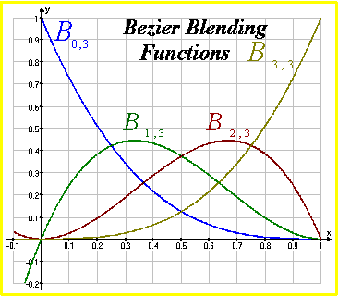

Example
Cubic Bézier Curves
Cubic Bézier curves are generated with four control points.
The four blending functions for cubic Bézier curves (n=3):

Slide 28
Design Techniques Using Bézier ‍Curve
(Complicated curves)

Slide 29
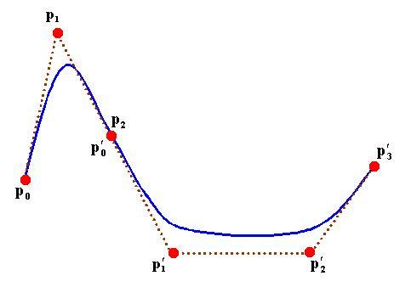

Design Techniques Using Bézier ‍Curve
(Complicated curves)
When complicated curves are to be generated, they can be formed by piecing several Bézier sections of lower degree together.
Piecing together smaller sections gives us better control over the shape of the curve in small region.

Slide 30

Design Techniques Using Bézier ‍Curve
(Complicated curves)
Since Bézier curves pass through endpoints;
it is easy to match curve sections (C⁰ continuity)
Zero order continuity:
P´₀=P₂

Slide 31


Design Techniques Using Bézier ‍Curve
(Complicated curves)
Since the tangent to the curve at an endpoint is along the line joining that endpoint to the adjacent control point;

Slide 32

Design Techniques Using Bézier ‍Curve
(Complicated curves)
To obtain C¹ continuity between curve sections, we can pick control points P´₀ and P´₁ of a new section to be along the same straight line as control points P_{n-1} and P_{n} of the previous section
First order continuity:
P₁, P₂, and P´₁ collinear.

Slide 33

Design Techniques Using Bézier ‍Curve
(Complicated curves)
This relation states that to achieve C¹ continuity at the joining point the ratio of the length of the last leg of the first curve (i.e., |p_{m} - p_{m-1}|) and the length of the first leg of the second curve (i.e., |q₁ - q₀|) must be n/m. Since the degrees m and n are fixed, we can adjust the positions of p_{m-1} or q₁ on the same line so that the above relation is satisfied

Slide 34
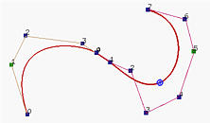

Design Techniques Using Bézier ‍Curve
(Complicated curves)
The left curve is of degree 4, while the right curve is of degree 7. But, the ratio of the last leg of the left curve and the first leg of the second curve seems near 1 rather than 7/4=1.75. To achieve C¹ continuity, we should increase (resp., decrease) the length of the last (resp. first) leg of the left (resp., right). However, they are G1 continuous

Slide 35

Cubic
Bézier Curves

Slide 36
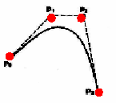
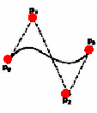
Cubic Bézier Curves
Cubic Bézier curves gives reasonable design flexibility while avoiding the increased calculations needed with higher order polynomials.

Slide 37

Cubic Bézier Curves
Cubic Bézier curves are generated with four control points.
The four blending functions for cubic Bézier curves (n=3):

Slide 38
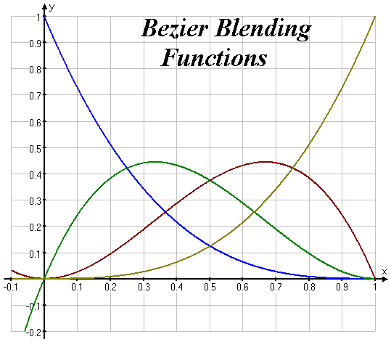
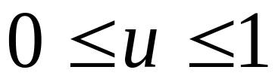
Cubic Bézier Curves
At u=0, B_{0,3}=1, and at u=1, B_{3,3}=1. thus, the curve will always pass through control points P₀ and P₃.
The functions B_{1,3} and B_{2,3}, influence the shape of the curve at intermediate values of parameter u, so that the resulting curve tends toward points P₁ and P₃.
At u=1/3, B_{1,3} is maximum, and at u=2/3, B_{2,3} is maximum.

Slide 39
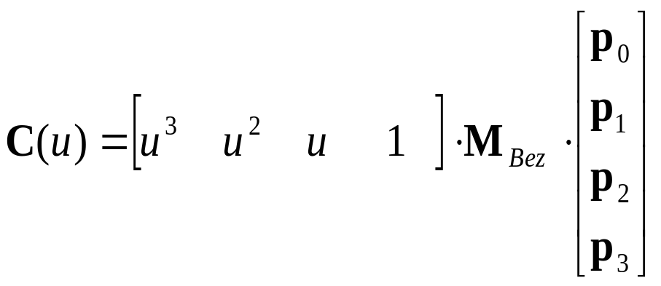
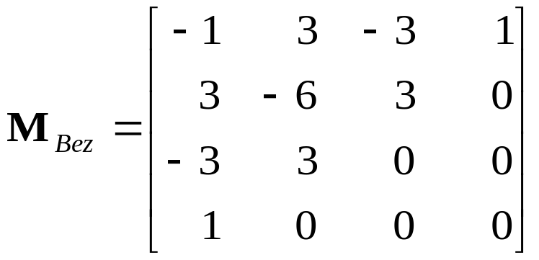
Cubic Bézier Curves
At the end positions of the cubic Bézier curve, The parametric first and second derivatives are:
With C¹ and C² continuity between sections, and by expanding the polynomial expressions for the blending functions: the cubic Bézier point function in the matrix form:

Slide 40

Finding a point on a Bézier Curve:
De Casteljau's Algorithm

Slide 41
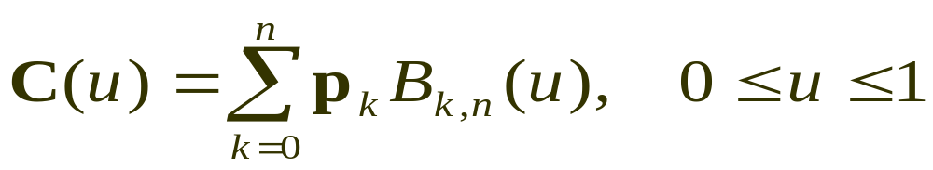
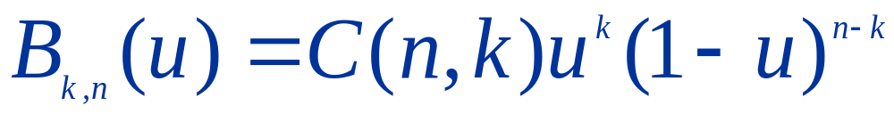
Finding a point on a Bézier Curve
A simple way to find the point C(u) on the curve for a particular u is
to plug u into every basis function
Compute the product of each basis function and its corresponding control point
Add them together.

Slide 42
Finding a point on a Bézier Curve
De Casteljau's Algoritm
The fundamental concept of de Casteljau's algoritm is to choose a point C in line segment AB such that C divides the line segment AB in a ratio of u:1-u.

Slide 43
Finding a point on a Bézier Curve
De Casteljau's Algoritm
The vector from A to B is B-A.
u is a ratio in the range of 0 and 1, point C is located at u(B-A).
Taking the position of A into consideration, point C is
A+u(B-A)=(1-u)A+uB

Slide 44
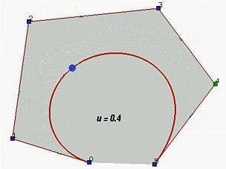
De Casteljau's Algoritm
Casteljau's algorithm: we want to find C(u), where u is in [0,1].
Starting with the first polyline, 00-01-02-03…-0n, use the formula to find a point 1i on the leg from 0i to 0(i+1) that divides the line segment in a ratio of u:1-u. we ill obtain n point 10,11,12,…,1(n-1), they defind a new polyline of n-1 legs.

Slide 45
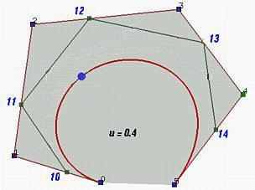
De Casteljau's Algoritm
Casteljau's algorithm: we want to find C(u), where u is in [0,1].
Starting with the first polyline, 00-01-02-03…-0n, use the formula to find a point 1i on the leg from 0i to 0(i+1) that divides the line segment in a ratio of u:1-u. we ill obtain n point 10,11,12,…,1(n-1), they defind a new polyline of n-1 legs.

Slide 46
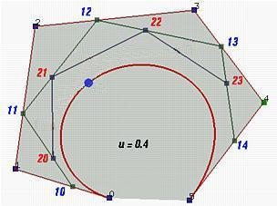
De Casteljau's Algoritm
Apply the procedure to this new polyline and we shall get a third polyline of n-1 points 20-21-…,2(n-2) and n-2 legs.

Slide 47
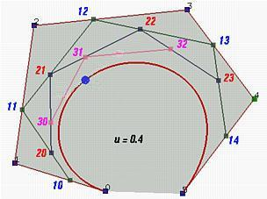
De Casteljau's Algoritm
Apply the procedure to this new polyline and we shall get a fourth polyline of n-1 points 30-31-…,3(n-3) and n-3 legs.

Slide 48
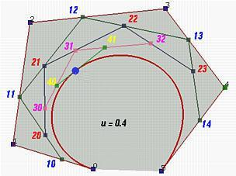
De Casteljau's Algoritm
From this fourth polyline, we have the fifth one of two points 40 and 41.

Slide 49
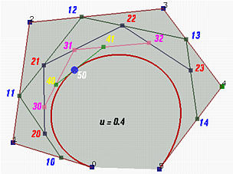
De Casteljau's Algoritm
Do it once more, and we have 50, the point C(0.4) on the curve.
De Casteljau proved that this is the point C(u) on the curve that corresponds to u.

Slide 50
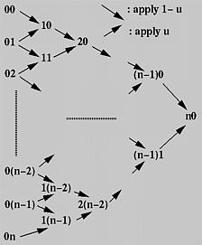
De Casteljau's Algoritm Actual Compution
From the initial column, column 0, we compute column 1; from column 1 we obtain column 2 and so on. After n applications we shall arrive at a single point n0 and this is the point on the curve.

Slide 51

Subdivision a Bézier Curve

Slide 52
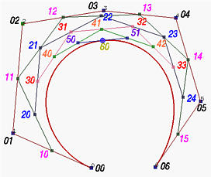
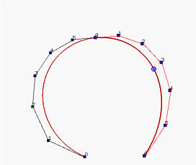
Subdivision a Bézier Curve
Given s set of n+1 control points P₀,p₁,P₂, …,P_{n} and a parameter value u in the range of 0 and 1, we wannt to find two sets of n+1 control points Q₀,Q₁,Q₂, ..,Q_{n} and R₀,R₁,R₂,…,R_{n} such that the Bézier curve definde by Q_{i}’s (resp. R_{i}’s) is the piece of the original Bézier curve on [0,u] (resp., [u,1]).

Slide 53
Subdivision a Bézier Curve
Left polyline consists of points P₀₀=P₀,P₁₀,P₂₀,P₃₀,P₄₀,P₅₀ and P₆₀=C(u).
Right polyline consist of points P₆₀=C(u),P₅₁,P₄₂,P₃₃,P₂₄,P₁₅ and P₀₆=P₆.

Slide 54
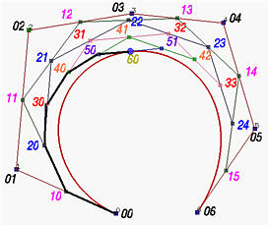
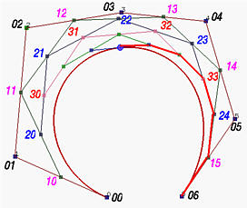
Subdivision a Bézier Curve

Slide 55
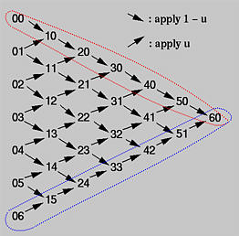
Subdivision a Bézier Curve

Slide 56
Subdivision a Bézier Curve
Note that since the line segment defined by 50 and 51 is tangent to the curve at point 60, the last leg of the left curve (i.e, point 50 to point 60) is tangent to the left curve, and the first leg on the right curve (i.e, point 60 to point 51) is tangent to the right curve.

Slide 57
Subdivision a Bézier Curve
Why Do we need curve Subdivision?
Used for:
Computating the intersection of two Bézier curves
Rendering Bézier curves
Making curve design easier.

